Slide 1
Summarizing Data
Using SQLPathFinder
(view in slide show mode)

Slide 2
Often you need to summarize your output. E.g., you may wish to return the average and standard deviation of an SPC parameter by lot and wafer identifier. This section describes how to create summary queries in SQLPathFinder

Slide 3
Statistical Summaries
Summary functions generally operate on groups of
rows to produce one result per group. E.g.,
Notes:
Group Functions
Group functions operate on sets of rows to give one result per group. These sets may be the whole table or the table split into groups.

Slide 4
Statistical Summaries
Summary functions generally operate on groups of
rows to produce one result per group. E.g.,
WAFER_ID VALUE
--------- ---------
010 2450
010 5000
010 1300
020 800
020 1100
020 3000
020 3000
020 2975
030 1600
030 2850
030 1250
030 950
030 1500
030 1250
2916.6667
“average
value
for each
WAFER ID”
WAFER_ID AVG(VALUE)
------- ---------
010 2916.67
020 2175
030 1566.67
2175
1566.6667
Notes:
Group Functions
Group functions operate on sets of rows to give one result per group. These sets may be the whole table or the table split into groups.

Slide 5
Statistical Summaries
SQLPathFinder supports the following
summary functions:
    Avg, StdDev, Max, Min, Count, Sum, Variance
    Percentiles (P1,P5,P25,P50,P75,P90,P95,P99)
    All functions are not available in every database, but SQLPathFinder will tell you which ones you can use at a given time
Notes:
Group Functions
AVG ([DISTINCT|ALL]n)
COUNT ({ *|[DISTINCT|ALL]expr})
MAX ([DISTINCT|ALL]expr)
MIN ([DISTINCT|ALL]expr)
STDDEV ([DISTINCT|ALL]x)
SUM ([DISTINCT|ALL]n)
VARIANCE ([DISTINCT|ALL]x)
Guidelines for Using Group Functions
DISTINCT makes the function consider only nonduplicate values; ALL makes it consider every value including duplicates. The default is ALL and therefore does not need to be specified.
The datatypes for the arguments may be CHAR, VARCHAR2, NUMBER, or DATE where expr is listed.
All group functions except COUNT(*) ignore null values. To substitute a value for null values, use the NVL function

Slide 6
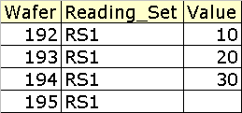
Statistical Functions & Null Values
Statistical functions ignore null (or missing) values
E.g., the average of all values in the below table where one reading is Null is?
Notes:
Group Functions and Null Values
All group functions except COUNT (*) ignore null values in the column. In the above example, the average is calculated based only on the rows in the table where a valid value is stored in the VALUE column. The average is calculated as total of VALUE (i.e., 60 excluding NULLS) divided by the number of non-Null rows (3).

Slide 7
Statistical Functions & Null Values
Statistical functions ignore null (or missing) values
E.g., the average of all values in the below table where one reading is Null is:
60/3
… as the 4th
value is Null
AVG(VALUE)
---------
20
Notes:
Group Functions and Null Values
All group functions except COUNT (*) ignore null values in the column. In the above example, the average is calculated based only on the rows in the table where a valid value is stored in the VALUE column. The average is calculated as total of VALUE (i.e., 60 excluding NULLS) divided by the number of non-Null rows (3).

Slide 8
Statistical Functions & Null Values
Expression SPF_FN$IFNULL (Value, 0) can force aggregates to include null values
  If the function’s argument 1 (value) is null return argument 2 (0), else return argument 1 (value)
  AVG(SPF_FN$IFNULL (Value, 0)) for all rows below equals?
Notes:
Statistical Functions and Null Values (continued)
The NVL function forces group functions to include null values. In the above example, the average is calculated based on all rows in the table regardless of whether null values are stored in the VALUE column. The average is calculated as total of VALUE divided by the total number of rows (4).
NVL takes two arguments, the column it is testing and the value to be substituted if the column is NULL.

Slide 9
Statistical Functions & Null Values
Expression SPF_FN$IFNULL (Value, 0) can force aggregates to include null values
  If the function’s argument 1 (value) is null return argument 2 (0), else return argument 1 (value)
  AVG(SPF_FN$IFNULL (Value, 0)) for all rows below equals:
60/4
AVG( SPF_FN$IFNull(VALUE,0) )
-----------------------------
15
Notes:
Statistical Functions and Null Values (continued)
The NVL function forces group functions to include null values. In the above example, the average is calculated based on all rows in the table regardless of whether null values are stored in the VALUE column. The average is calculated as total of VALUE divided by the total number of rows (4).
NVL takes two arguments, the column it is testing and the value to be substituted if the column is NULL.

Slide 10
The COUNT Function
COUNT(*) returns the total rows in a data set
COUNT(expr) returns the number of non-null rows for expr
COUNT(DISTINCT expr) returns distinct non-null rows for expr
Notes:
The COUNT Function
The COUNT function has two formats:
COUNT(*)
COUNT(expr).
COUNT(*) returns the number of rows in a table, including duplicate rows and rows containing null values.
In contrast, COUNT(expr) returns the number of nonnull rows in the column identified by expr

Slide 11
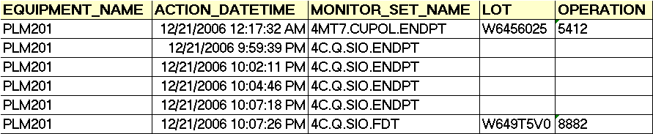
The COUNT Function
COUNT(*) returns the total rows in a data set
COUNT(expr) returns the number of non-null rows for expr
COUNT(DISTINCT expr) returns distinct non-null rows for expr
Count(*), Count(Lot) and Count(Distinct Equipment_Name) applied below result in?
Notes:
The COUNT Function
The COUNT function has two formats:
COUNT(*)
COUNT(expr).
COUNT(*) returns the number of rows in a table, including duplicate rows and rows containing null values.
In contrast, COUNT(expr) returns the number of nonnull rows in the column identified by expr

Slide 12
The COUNT Function
COUNT(*) returns the total rows in a data set
COUNT(expr) returns the number of non-null rows for expr
COUNT(DISTINCT expr) returns distinct non-null rows for expr
Count(*), Count(Lot) and Count(Distinct Equipment_Name) applied below results in:
COUNT(*) COUNT(LOT) COUNT(DISTINCT EQUIPMENT_NAME)
--------- --------- ------------------------------
6 2 1
Notes:
The COUNT Function
The COUNT function has two formats:
COUNT(*)
COUNT(expr).
COUNT(*) returns the number of rows in a table, including duplicate rows and rows containing null values.
In contrast, COUNT(expr) returns the number of nonnull rows in the column identified by expr

Slide 13
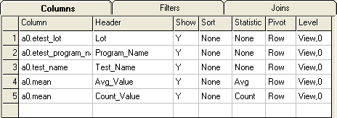
Statistical Summaries
You create summaries in SQLPathFinder using the STATISTIC column on the Columns Grid

Slide 14
Statistical Summaries
Columns with no Statistic and a Show attribute of Y serve as grouping columns for the statistical summary
}
Grouping
Columns
For
Summary

Slide 15
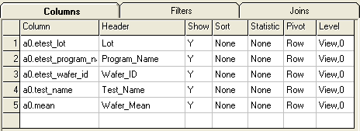
Statistical Summaries
Lot | Program _Name | Wafer _ID | Test_Name | WaferMean
F5403038 | 12640EE93 | 793 | ACLEN_04 | .0162
F5403038 | 12640EE93 | 756 | ACLEN_04 | .0158
F5403038 | 12640EE93 | 798 | ACLEN_04 | .0158
F5403038 | 12640EE93 | 704 | ACLEN_04 | .0153
F5403038 | 12640EE93 | 792 | ACLEN_04 | .0154
The above query pulls E-Test wafer level summary data for a program name and test name.
Suppose we wish to rollup this data to the lot level, and compute the average E-Test lot value as well as a count of the number of wafers in the lot
Notes:
1. Shown are the results of a query prior to the summary
2. Statistics are assigned by specifying a summary statistic in the Summary column of the Query Grid.
All columns in the Query Grid with a DISPLAY attribute of Y and with no SUMMARY attribute act as the grouping columns for the summary

Slide 16
Statistical Summaries
Lot | Program _Name | Wafer _ID | Test_Name | WaferMean
F5403038 | 12640EE93 | 793 | ACLEN_04 | .0162
F5403038 | 12640EE93 | 756 | ACLEN_04 | .0158
F5403038 | 12640EE93 | 798 | ACLEN_04 | .0158
F5403038 | 12640EE93 | 704 | ACLEN_04 | .0153
F5403038 | 12640EE93 | 792 | ACLEN_04 | .0154
To do so, column wafer_id is removed from the query, column a0.mean is added a second time, and an Avg and Count statistic is added for the wafer mean columns
Notes:
1. Shown are the results of a query prior to the summary
2. Statistics are assigned by specifying a summary statistic in the Summary column of the Query Grid.
All columns in the Query Grid with a DISPLAY attribute of Y and with no SUMMARY attribute act as the grouping columns for the summary

Slide 17
Statistical Summaries
Lot | Program _Name | Wafer _ID | Test_Name | WaferMean
F5403038 | 12640EE93 | 793 | ACLEN_04 | .0162
F5403038 | 12640EE93 | 756 | ACLEN_04 | .0158
F5403038 | 12640EE93 | 798 | ACLEN_04 | .0158
F5403038 | 12640EE93 | 704 | ACLEN_04 | .0153
F5403038 | 12640EE93 | 792 | ACLEN_04 | .0154
Lot | Program _Name | Test_ Name | Avg_ Value | Count_Value
F5403038 | 12640EE93 | ACLEN_04 | .0157 | 5
One summary row showing the average E-Test value and a count of values is created for grouping columns
Lot, Program_Name and Test_Name
Notes:
1. Shown are the results of a query prior to the summary
2. Statistics are assigned by specifying a summary statistic in the Summary column of the Query Grid.
All columns in the Query Grid with a DISPLAY attribute of Y and with no SUMMARY attribute act as the grouping columns for the summary

Slide 18
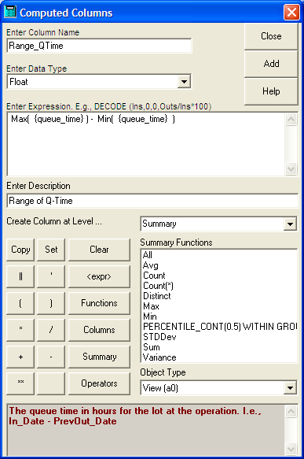
Statistical Expressions
  SQLPathFinder
  also supports
  statistical
  expressions
  when building
  Computed
  Columns
Notes:
Group Functions
AVG ([DISTINCT|ALL]n)
COUNT ({ *|[DISTINCT|ALL]expr})
MAX ([DISTINCT|ALL]expr)
MIN ([DISTINCT|ALL]expr)
STDDEV ([DISTINCT|ALL]x)
SUM ([DISTINCT|ALL]n)
VARIANCE ([DISTINCT|ALL]x)
Guidelines for Using Group Functions
DISTINCT makes the function consider only nonduplicate values; ALL makes it consider every value including duplicates. The default is ALL and therefore does not need to be specified.
The datatypes for the arguments may be CHAR, VARCHAR2, NUMBER, or DATE where expr is listed.
All group functions except COUNT(*) ignore null values. To substitute a value for null values, use the NVL function

Slide 19
Statistical Expressions
  SQLPathFinder
  also supports
  statistical
  expressions
  when building
  Computed
  Columns
Select Summary Level to add Statistical Functions
Notes:
Group Functions
AVG ([DISTINCT|ALL]n)
COUNT ({ *|[DISTINCT|ALL]expr})
MAX ([DISTINCT|ALL]expr)
MIN ([DISTINCT|ALL]expr)
STDDEV ([DISTINCT|ALL]x)
SUM ([DISTINCT|ALL]n)
VARIANCE ([DISTINCT|ALL]x)
Guidelines for Using Group Functions
DISTINCT makes the function consider only nonduplicate values; ALL makes it consider every value including duplicates. The default is ALL and therefore does not need to be specified.
The datatypes for the arguments may be CHAR, VARCHAR2, NUMBER, or DATE where expr is listed.
All group functions except COUNT(*) ignore null values. To substitute a value for null values, use the NVL function

Slide 20
Statistical Expressions
  SQLPathFinder
  also supports
  statistical
  expressions
  when building
  Computed
  Columns
Click the Summary button to see Statistical
functions
Notes:
Group Functions
AVG ([DISTINCT|ALL]n)
COUNT ({ *|[DISTINCT|ALL]expr})
MAX ([DISTINCT|ALL]expr)
MIN ([DISTINCT|ALL]expr)
STDDEV ([DISTINCT|ALL]x)
SUM ([DISTINCT|ALL]n)
VARIANCE ([DISTINCT|ALL]x)
Guidelines for Using Group Functions
DISTINCT makes the function consider only nonduplicate values; ALL makes it consider every value including duplicates. The default is ALL and therefore does not need to be specified.
The datatypes for the arguments may be CHAR, VARCHAR2, NUMBER, or DATE where expr is listed.
All group functions except COUNT(*) ignore null values. To substitute a value for null values, use the NVL function

Slide 21
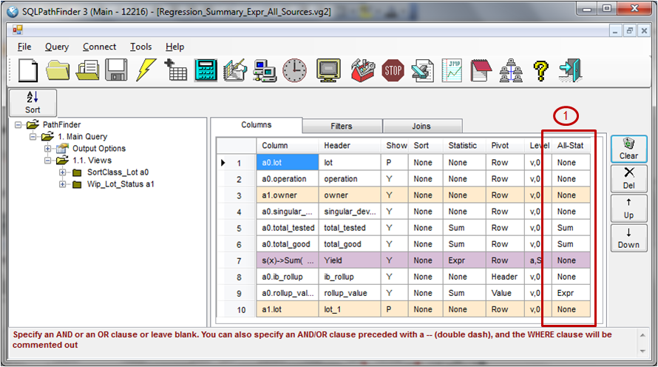
All Sources Summaries
  Summaries can also be defined at the All Sources level,
  i.e., for queries that use multiple views. To do so,
  assign Summaries using the All-Stat column (1).
  Click here for more help on that.

Slide 22
Final Quiz!
Following are a few questions on Summaries.
Notes:
22

Slide 23
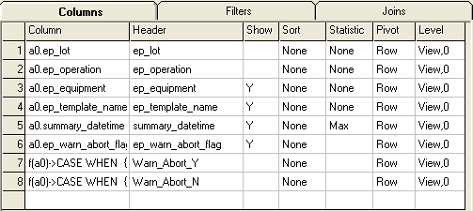
What values should you assign to the Show & Statistic cells to get the desired output?
Right-click and choose Pointer Options -> Pen to record responses.
Go to next slide to see an answer
OUTPUT: Count of Rows Where Warn and Abort are Y vs. N
Warn_Abort_Y
CASE WHEN {ep_warn_abort_flag} = 'Y' Then 1
ELSE 0 END
Warn_Abort_N
CASE WHEN {ep_warn_abort_flag} = 'N' Then 1
ELSE 0 END
N

Slide 24
What values should you assign to the Show & Statistic cells to get the desired output?
OUTPUT: Count of Rows Where Warn and Abort are Y vs. N
Warn_Abort_Y
CASE WHEN {ep_warn_abort_flag} = 'Y' Then 1
ELSE 0 END
Warn_Abort_N
CASE WHEN {ep_warn_abort_flag} = 'N' Then 1
ELSE 0 END
N
N
N
None
Y
Sum
Y
Sum

Slide 25
That concludes the presentation
on Summaries in SQLPathFinder

